Slide 1
Lecture 2: Algorithm Complexity
Tsung-Wei (TW) Huang
Department of Electrical and Computer Engineering
University of Utah, Salt Lake City, UT

Slide 2
Recap: We Need Algorithms!
To optimize design among different objectives, area, power, performance, and etc.
Fundamental questions: How to do it smartly?
Definition of algorithm in a board sense: A step-by-step procedure for solving a problem. Examples:
Cooking a dish
Making a phone call
Sorting a hand of cards
Definition for computational problem
A well-defined computational procedure that takes some value as input and produces some value as output

Slide 3
Computational Complexity
Computational complexity is an abstract measure of the time and space necessary to execute an algorithm as function of its input size
The input is the graph G(V,E)
input size = |V| and |E|
The input is the truth table of an n-variable Boolean function
input size = 2^{n}
What’s the growth of algorithm complexity in terms of input size?
Best case?
Worst case?

Slide 4
Time and Space Complexity
Time complexity expresses elementary computational steps
example: addition (or multiplication, or value assignment etc.) is one step
normally, by "most efficient" algorithm we mean the fastest
Space complexity expresses memory locations
e.g. in bits, bytes, words

Slide 5
Analysis of an Algorithm
There are different algorithms to solve the same problem
Remember our Big-Mod problem in Lecture 1?
We need some way to compare 2 algorithms
Usually the run time is the criteria used
However, difficult to compare since algorithms may be implemented in different machines, use different languages, etc.
Also, run time is input-dependent.
Which input to use?
Which case do we consider? Worst or best?

Slide 6
Big-O Notation
Consider run time for the worst input
upper bound on run time
Express run time as a function input size n
Interested in the run time for large inputs
Therefore, interested in the growth rate
Ignore multiplicative constant
+,-,x,/,… operators treated as constant-time computations
Ignore lower order terms
Eventually, the highest order dominates the growth

Slide 7
Big-O Notation (cont’d)
g = O(f), if two constants n₀ and K can be found such that for all n ≥ n₀ :
g (n) ≤ K ⋅ f(n)
Examples:
2n² = O(n²)
2n² + 3n +1 = O(n²)
n^{1.1}+10000000000n is O(n^{1.1})
n^{1.1} = O(n²)

Slide 8
Example: Big-Mod Complexity
Compute a^{b} mod c (b is as large as 2147483647)
Naïve method
for(i=1, j=1; i<=b; i++)
j = (j*a)%c;
2¹⁶ = 2*2*2*2*2*2*…*2 total 15 calculation
Refined solution
2¹⁶ = ( 2⁸ )² total 1 calculation
2⁸ = ( 2⁴ )² total 1 calculation
2⁴ = ( 2² )² total 1 calculation
2² = ( 2¹ )² total 1 calculation
2¹ = ( 2⁰ ) total 1 calculation
What is the space and time complexities for each method in terms of big-O notation?

Slide 9
Empirical Analysis
Technical Analysis(Input Data Size = N)
O(N)
for(int i=1; i<=N; i++) some_constant_work();
O(N²)
for(int i=1; i<=N; i++)
for(int j=1; j<=N; j++)
some_constant_time_work();
O(N³), O(N⁴)…
On modern computers, input Data Size = N
O(N) = 1000000 ~ 8000000 takes about 1s to finish
Generally true on modern PCs

Slide 10
Empirical Analysis (cont’d)
A Problem with N = 1000, Time Limit = 1s
Could a O(N) algorithm pass the time limit constraint?
What about the O(NlogN)?
What about the O(N²) ?
What about the O(N² logN) ?
What about the O(1) time ?
A Problem with N = 1000000, Time Limit = 1s
Could a O(N) algorithm pass the time limit constraint?
What about the O(logN) ?
What about the O(logN logN) ?
What about the O(N²) ?

Slide 11
Example: Selection Sort
Input: An array of n numbers D[1]…D[n]
Output: An array of n numbers E[1]…E[n] such that
E[1] E[2] … E[n]
Algorithm:
For i from 1 to n do
Select the largest remaining number from D[1..n]
Put that number into E[i]
What is the space and time complexities for each method in terms of big-O notation?

Slide 12
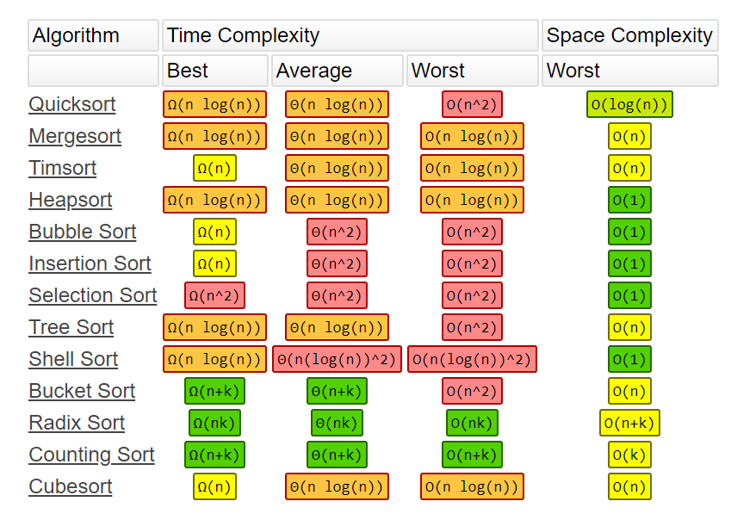
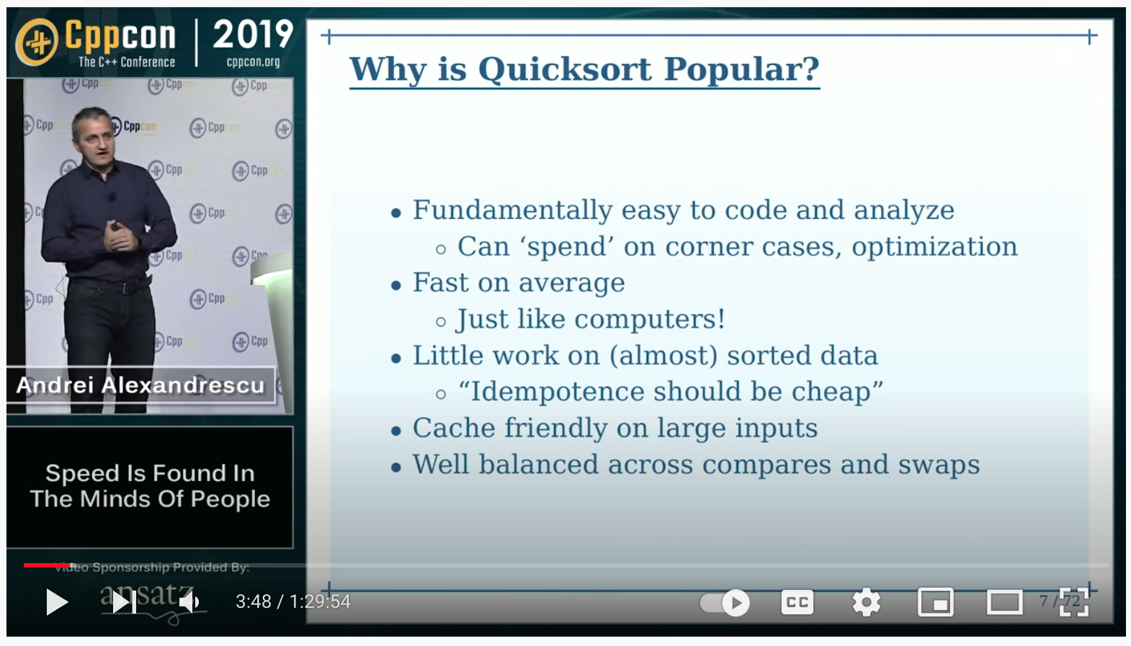
Time Complexity of Sorting Algorithms
Andrei Alexandrescu, “Speed is Found in Minds of People,” CppCon 2019 (https://www.youtube.com/watch?v=FJJTYQYB1JQ)

Slide 13
Some Algorithm Design Techniques
Greedy
Divide and Conquer
Dynamic Programming
Network Flow
Mathematical Programming
Linear programming
Integer linear programming
Quadratic programming
…

Slide 14
Growth Rates of Complexity Functions
Polynomial
Functions
Exponential
Functions

Slide 15
Problem of Exponential Function
Consider 2^{n}, value doubled when n is increased by 1.
If you borrow $10 from a credit card with APR 18%, after 40 yrs, you will owe $12700!
n | 2^{n} | 1μs x 2^{n}
10 | 10³ | 0.001 s
20 | 10⁶ | 1 s
30 | 10⁹ | 16.7 mins
40 | 10¹² | 11.6 days
50 | 10¹⁵ | 31.7 years
60 | 10¹⁸ | 31710 years

Slide 16
Exponential Time Complexity
An algorithm has an exponential time complexity if its execution time is given by the formula
execution time = k₁·(k₂)^{n}
where n is the size of the input data and k₁, k₂ are constants

Slide 17
Exponential Time Complexity
The execution time grows so fast that even the fastest computers cannot solve problems of practical sizes in a reasonable time
The problem is called intractable if the best algorithm known to solve this problem requires exponential time
Many CAD problems are intractable
Partition a circuit of billions of components with various constraints
Place millions of cells in a die with various constraints

Slide 18
Complexity Classes: P Class
Class P contains those problems that can be solved in polynomial time (the number of computation steps necessary can be expressed as a polynomial of the input size n).
The computer concerned is a deterministic Turing machine

Slide 19
Deterministic Turing Machine
A mathematical model of a universal computer
Any computation that needs polynomial time on a Turing machine can also be performed in polynomial time on any other machine
Deterministic means each step in a computation is predictable
Finite state control
Tape
Read-write head
...
...
-3
-2
-1
0
1
2
3

Slide 20
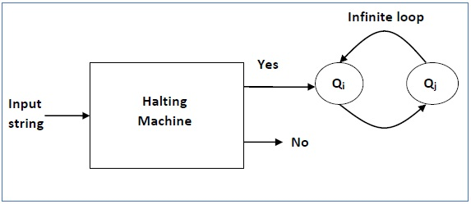
Undecidable Decision Problem
The Halting Problem
the problem of determining, from a description of an arbitrary computer program and an input, whether the program will finish running (i.e., halt) or continue to run forever

Slide 21
Non-deterministic Turing Machine
If solution checking for some problems can be done in polynomial time on a deterministic machine, then the problem can be solved in polynomial time on a non-deterministic Turing machine
Can imagine non-deterministic Turing machine as a very powerful machine that can spawn many parallel search paths each solving the problem deterministically
Non-deterministic - 2 stages:
make a guess what the solution is
check whether the guess is correct

Slide 22
Complexity Classes: NP Class
Class NP contains those problems that can be solved in polynomial time on a non-deterministic Turing machine
NP
P
All problems

Slide 23
NP-complete Problem Class
A question which is still not answered:
P = NP or P ≠ NP
There is a strong belief that P≠ NP, due to the existence of NP-complete problems (NPC)
All NPC problems have the same degree of difficulty
If one of them could be solved in polynomial time, all of them would have a polynomial time solution

Slide 24
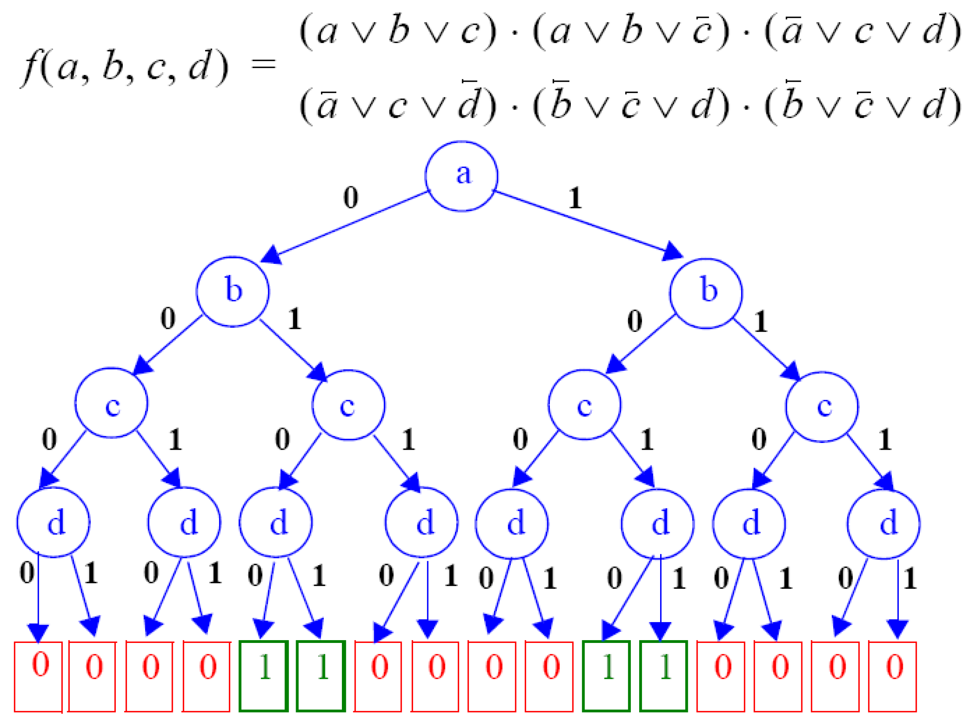
NP-complete Problem Definition
A problem is NP-complete if and only if
It is in NP
Some known NP-complete problem can be transformed to it in polynomial time
Cook’s theorem:
SATISFIABILITY is NP-complete
The first NP-complete problem
Every NP problem reduces to SAT

Slide 25
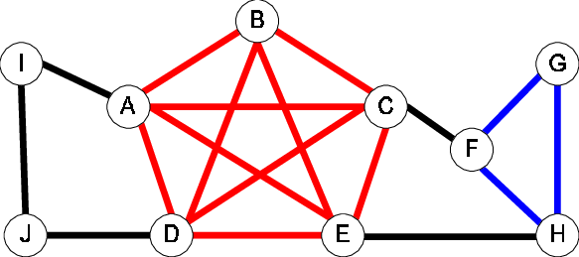
NP-complete Problem Examples (cont’d)
Clique finding problem
Input: graph G = (V,E), positive integer K ≤ |V|
Question: does G contain a clique of size K or more?
Minimum cover problem
Input: collection C of subsets of a finite set S, positive integer K ≤ |C|
Question: does G contain a cover for S of size K or less?

Slide 26
NP-complete Problem Examples (cont’d)
Circuit set problem
Take a Boolean circuit with a single output node and ask whether there is an assignment of values to the circuit’s inputs so that the output is “1”
Logic Gates
0
1
0
1
1
NOT
1
1
0
OR
1
1
0
0
1
AND

Slide 27
NP-complete Problem Examples (cont’d)
Knapsack problem
Can we translate a subset of rectangles to have their bottom edges on L so that the total area of the rectangles touching L is at least s?
5
6
2
3
4
7
1
L
s

Slide 28
Reduction
Idea: If we can solve problem A, and if problem B can be transformed into an instance of problem A with polynomial time, then we can solve problem B by reducing problem B to problem A and then solve the corresponding problem A
B <_{p} A
Example:
Problem A: Sorting
Problem B: Given n numbers, find the i-th largest numbers.
Polynomial-time Reducible

Slide 29
World of NP: Assuming P != NP
NP
NPC
P

Slide 30
NP-Hard Problems
Any decision problem (inside or outside of NP) to which we can transform an NP-complete problem to it in polynomial time will have a property that it cannot be solved in polynomial time, unless P = NP
Such problems are called NP-hard
“as hard as the NP-complete problems”

Slide 31
NP-Hard, NP, and NPC
NP-Hard
NP
NPC
P

Slide 32
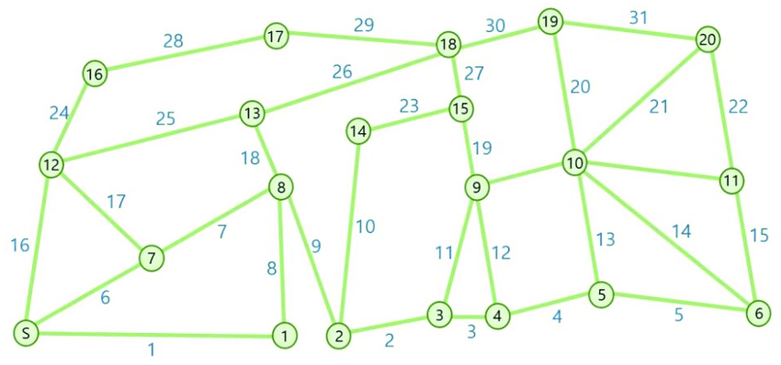
NP-hard Problem Examples
Traveling salesman problem (TSP)
Given a list of cities and the distances between each pair of cities, what is the shortest possible route that visits each city exactly once and returns to the origin city?

Slide 33
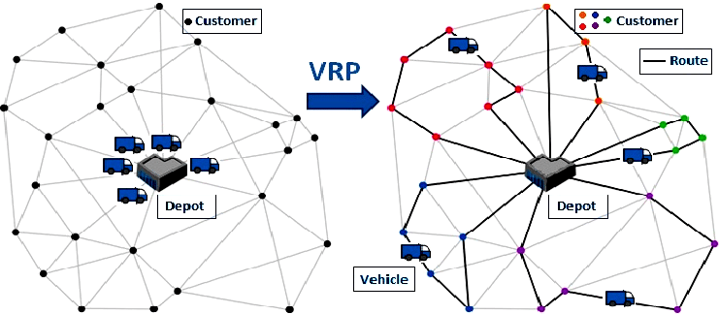
Applications of TSP
Vehicle routing problem (VRP)

Slide 34

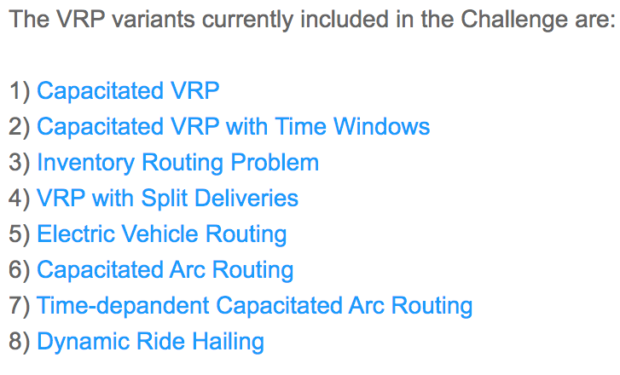
Applications of TSP (cont’d)
2020-2022 DIMACS Implementation Challenge: http://dimacs.rutgers.edu/programs/challenge/vrp/

Slide 35
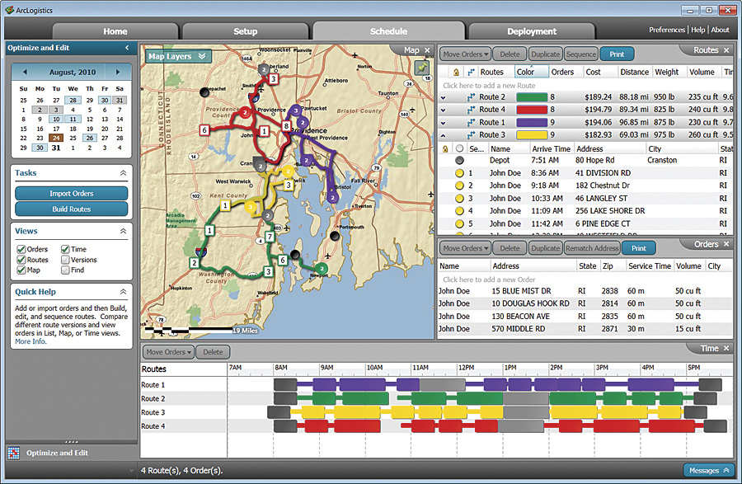
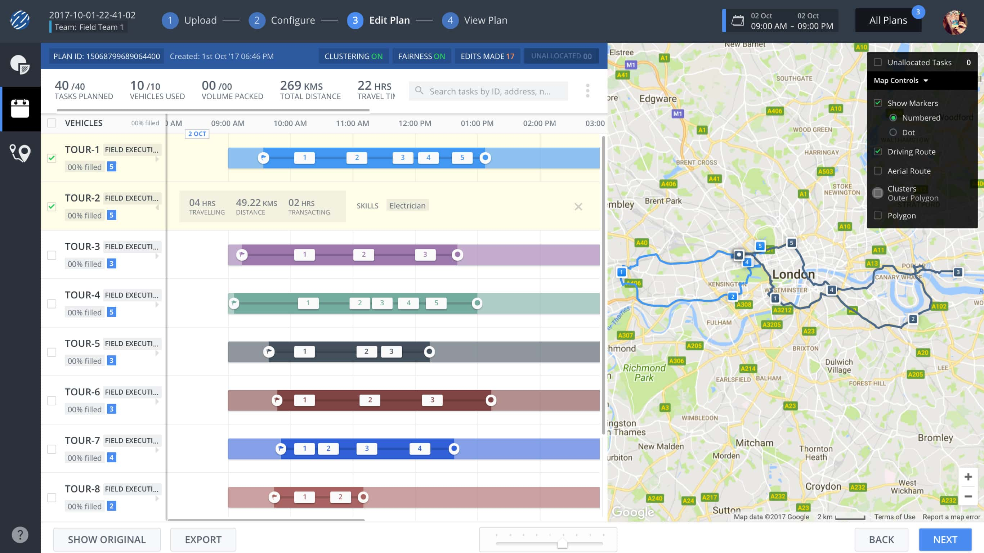
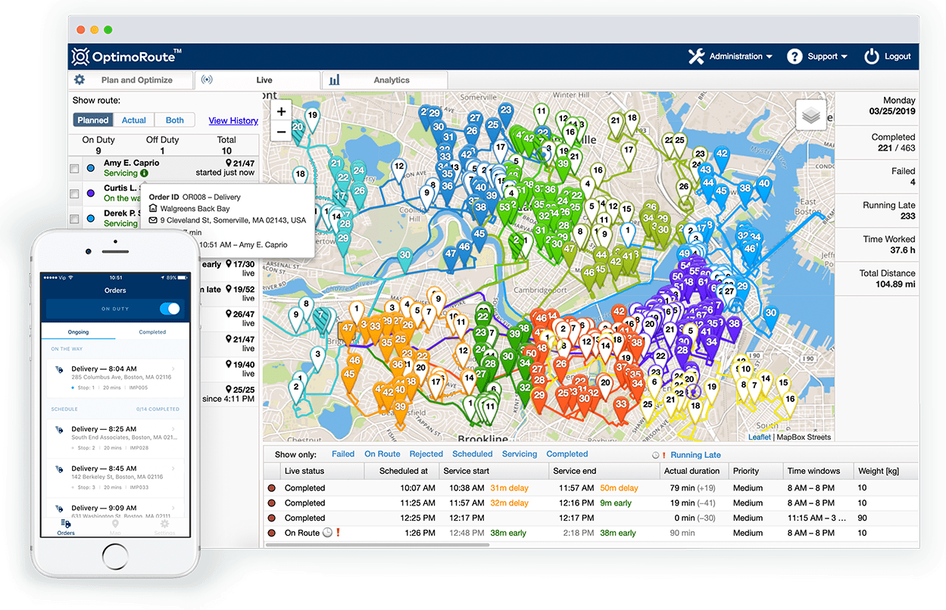
Vehicle Routing Software Solution

Slide 36
Practical Consequences
Many physical design problems are NP-C or NP-hard
Exact solutions to such problems are often of exponential complexity
Exact solutions to such problems can only be found when the problem size is small (e.g., N<=20)
One should instead focus on sub-optimal solutions by
Approximation algorithms: they can guarantee a solution within e.g. 20% of the optimum
Heuristics: nothing can be said a priori about the quality of the solution (experience-based)

Slide 37
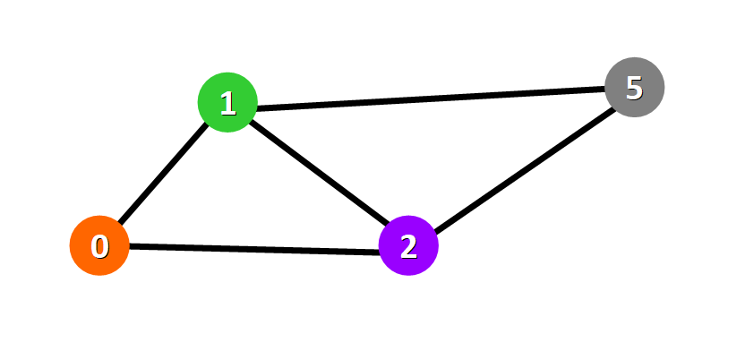
Example
Tractable and intractable problems can be very similar:
the SHORTEST-PATH problem for undirected graphs is in P
the LONGEST-PATH problem for undirected graphs is NP-complete

Slide 38
Summary
The class NP-complete is a set of problems which we believe there is no polynomial time algorithms
Therefore, it is a class of hard problems
NP-hard is another class of problems containing the class NP-complete
However, we don’t know if it belongs to NP
If we know a problem is in NP-complete or NP-hard, there is nearly no hope to solve it efficiently
Just keep this in mind if you still don’t understand it …

